Slide 1
Basic Concepts about ROS
Yonhon Ng
Robotic Vision Summer School
Kioloa Coastal Campus

Slide 2
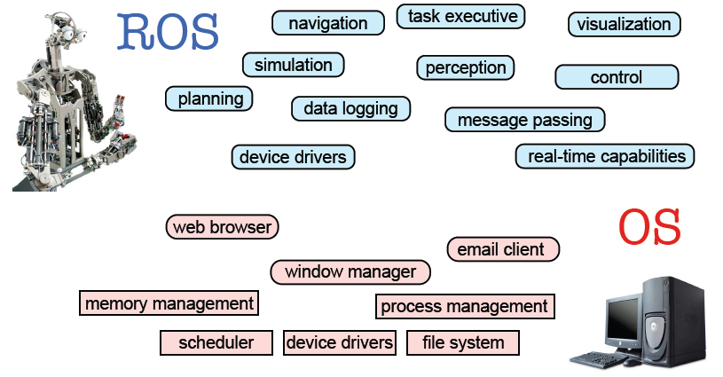
What is ROS
Sachin Chitta and Radu Rusu (Willow Garage)

Slide 3

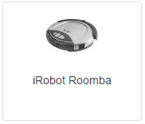
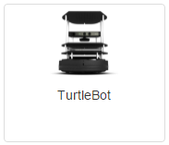
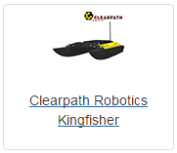
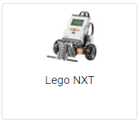
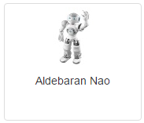
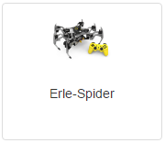
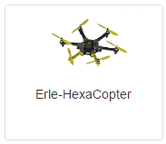
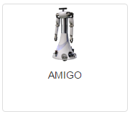
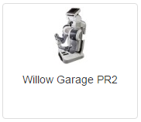
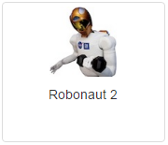
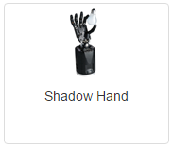
Robots that are using ROS
Full list at http://wiki.ros.org/Robots
etc.

Slide 4
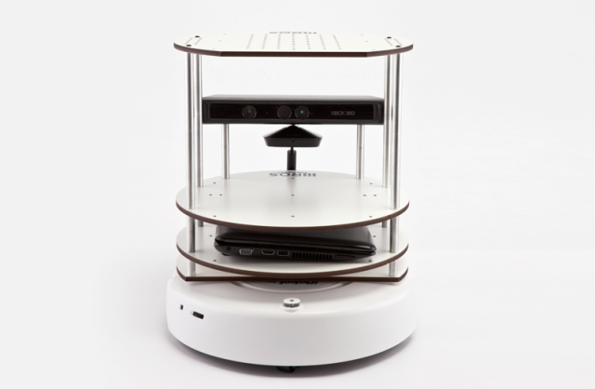
Robots that are using ROS

Slide 5
Why choose ROS?
It is all open source (BSD license).
The primary goal of ROS is to support code reuse in robotics research and development.
ROS is a distributed framework of processes (a.k.a. Nodes) that enables executables to be individually designed and loosely coupled at runtime.

Slide 6
Why choose ROS? (cont.)
ROS is easy to integrate with other robot software frameworks: ROS has already been integrated with OpenRAVE, Orocos, and Player.
Language independence: the ROS framework is easy to implement in any modern programming language. It has already been implemented it in Python, C++, and Lisp, and it has experimental libraries in Java and Lua.
Scaling: ROS is appropriate for large runtime systems and for large development processes.

Slide 7
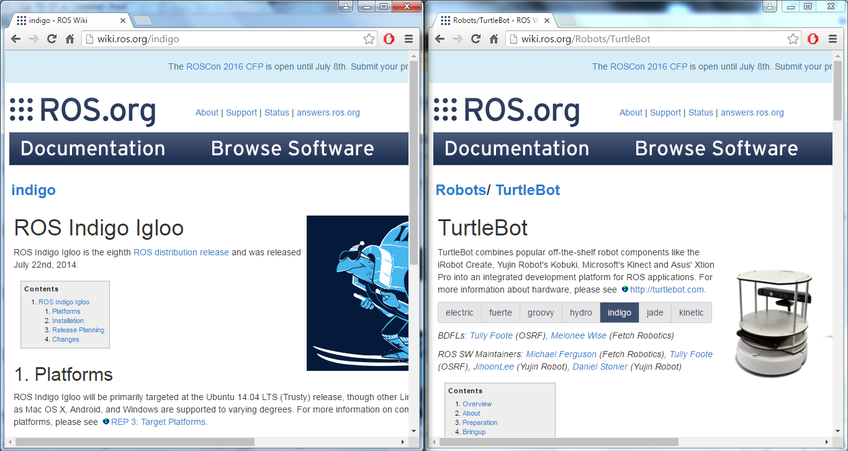
ROS website

Slide 8
Nodes
Single-purposed executable programs
e.g. sensor driver(s), actuator driver(s), mapper, planner, UI, etc.
Modular design
Individually compiled, executed, and managed
Written with the use of a ROS client library
Nodes communicate with each other using topics & services.
Executed with
$ rosrun <package name> <node name> [<arg:=value>]

Slide 9
Launch file
A convenient way to bringup many different nodes at once
Written in XML
Asynchronous execution
Can put parameters on server
Hierarchically compose collections of other launch files
Automatically re-spawn nodes if they crash
Easily distribute nodes across multiple machines
Executed with:
$ roslaunch <package name> <file.launch> [<arg:=value>]

Slide 10
Build System
Need to specify in 'Cmakelists.txt' how to build the source code of a package
To compile pkg + deps:
$ catkin_make
Compile multiple pkgs in parallel. ROS resolves deps first. 'ROS_PARALLEL_JOBS' = # of cores

Slide 11
Ways to communicate
Topic
Asynchronous "stream-like" communication
Many to many
Service
Synchronous "function-call-like" communication
one-to-one
Service roles:
carry out remote computation
trigger functionality / behavior

Slide 12
Messages
nodes communicate by passing around messages
A data structure with typed fields
many standard messages already exist, new messages can be defined with a simple text file
Can be comprised of other messages
For example, geometry_msgs/Twist.msg

Slide 13
Packages
A folder that contains your code, build files, launch files, etc.
Can contain any number of nodes
‘package.xml' – lists the ROS dependencies & system deps
Should only contain code that is related

Slide 14
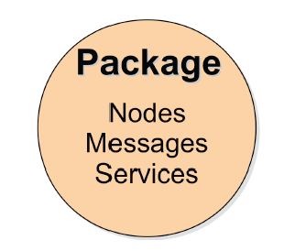
Packages
Software in ROS is organized in packages.
A package contains one or more nodes and provides a ROS interface

Slide 15
Package Examples
turtlebot_bringup – initialise turtlebot nodes
turtlebot_teleop – implements teleoperation of turtlebot (using keyboard or joystick)
turtlebot_dashboard – provides a graphical tool that shows overview of turtlebot status
move_base - implements the action of movement to a destination location
gmapping - perform laser-based SLAM (Simultaneous Localization and Mapping)

Slide 16
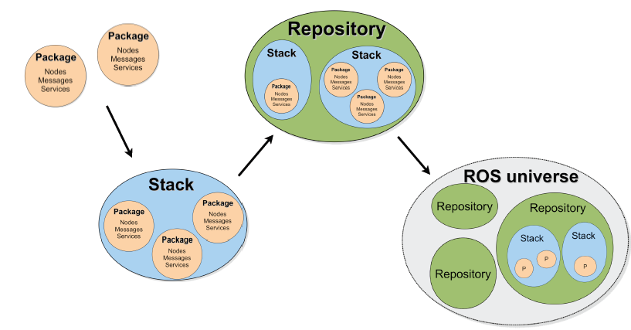
ROS Package System
Sachin Chitta and Radu Rusu (Willow Garage)

Slide 17

ROS Indigo
ROS version used is ROS Indigo Igloo
Targeted at the Ubuntu 14.04 LTS (Trusty) release

Slide 18
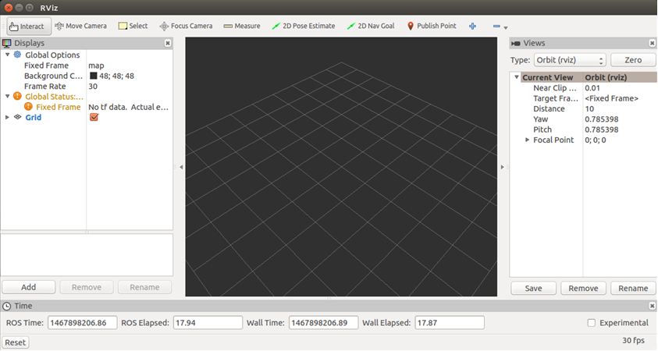
Visualizers: rviz

Slide 19
Create ROS Package
Create Workspace
$ mkdir –p ~/<workspace_name>/src
$ cd ~/<workspace_name>/src
$ catkin_init_workspace
$ cd ..
$ catkin_make
Create Package
$ cd ~/<workspace_name>/src
$ catkin_create_pkg <new_pkg_name> [dep1] [dep2] [depn]

Slide 20
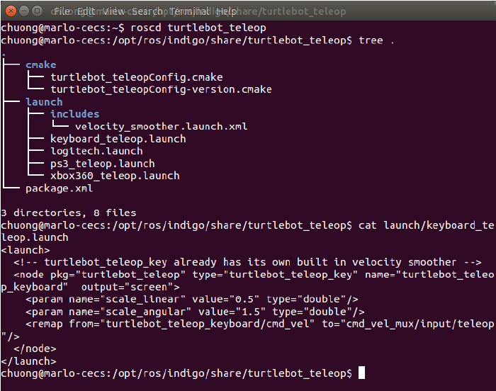
ROS Demo
$ echo $ROS_PACKAGE_PATH
$ rospack find turtlesim
$ roscd turtlesim
$ tree /opt/ros/indigo/share/turtlesim
# or
$ rosls turtlesim
$ rospack libs-only-L turtlesim
$ tree /opt/ros/indigo/lib/turtlesim

Slide 21
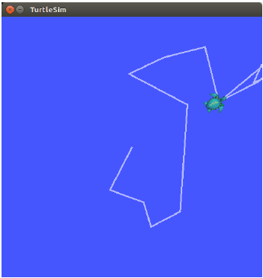

ROS demo - TurtleSim
$ roscore
$ rosrun turtlesim turtlesim_node
$ rosrun turtlesim turtle_teleop_key
$ rosrun rqt_graph rqt_graph

Slide 22
ROS demo - TurtleSim
$ rostopic -h
$ rostopic list
$ rostopic type /turtle1/cmd_vel
$ rosmsg show geometry_msgs/Twist
$ rostopic type /turtle1/cmd_vel | rosmsg show
$ rostopic echo /turtle1/cmd_vel
$ rostopic pub -1 /turtle1/cmd_vel geometry_msgs/Twist -- '[2.0, 0.0, 0.0]' '[0.0, 0.0, 1.8]'
$ rostopic pub /turtle1/cmd_vel geometry_msgs/Twist -r 1 -- '[2.0, 0.0, 0.0]' '[0.0, 0.0, 1.8]'

Slide 23
Launch file example - turtlemimic. launch
Create a Catkin workspace folder:
$ mkdir -p ~/catkin_ws/src
$ cd ~/catkin_ws/src
$ catkin_init_workspace
$ cd .. && catkin_make
$ source devel/setup.bash
Create package:
$ cd ~/catkin_ws/src
$ catkin_create_pkg beginner_tutorials
$ mkdir beginner_tutorials/launch
$ nano turtlemimic.launch
$ cd .. && catkin_make
$ roscd beginner_tutorials
$ rostopic pub /turtlesim1/turtle1/cmd_vel geometry_msgs/Twist -r 1 --'[2.0, 0.0, 0.0]' '[0.0, 0.0, -1.8]'
<launch>
<group ns="turtlesim1">
<node pkg="turtlesim" name="sim“ type="turtlesim_node"/>
</group>
<group ns="turtlesim2">
<node pkg="turtlesim" name="sim" type="turtlesim_node"/>
</group>
<node pkg="turtlesim" name="mimic" type="mimic">
<remap from="input" to="turtlesim1/turtle1"/>
<remap from="output" to="turtlesim2/turtle1"/>
</node>
</launch>

Slide 24
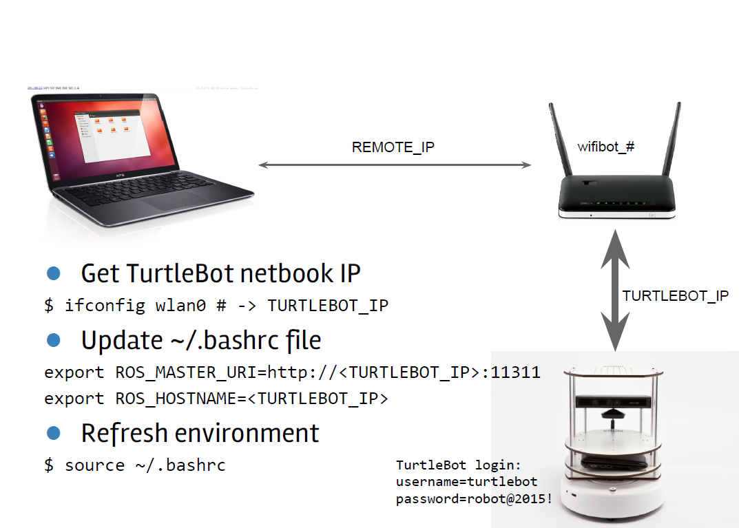
Operating Turtlebot – Turtlebot Setup
Do Once Only!
username = turtlebot-admin
Password = (ROS2015

Slide 25
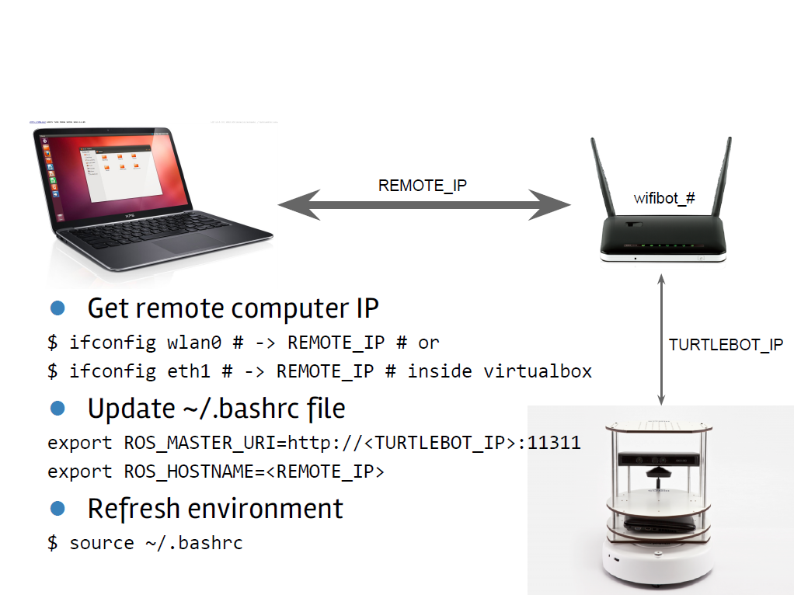
Operating Turtlebot – Remote Setup
Do Once Only!

Slide 26
Running Turtlebot
Initialisation on TurtleBot computer:
$ roslaunch turtlebot_bringup minimal.launch
$ roslaunch turtlebot_bringup 3dsensor.launch
Control (on TurtleBot or remote machine):
$ roslaunch turtlebot_teleop keyboard_teleop.launch
Visualisation (on TurtleBot or remote machine):
$ rosrun image_view image_view image:=/camera/rgb/image_raw
$ rosrun image_view disparity_view image:=/camera/depth/disparity
$ roslaunch turtlebot_rviz_launchers view_robot.launch
$ roslaunch turtlebot_dashboard turtlebot_dashboard.launch
$ rosrun rqt_graph rqt_graph

Slide 27
Rosbag Recording
Record and replay data from a ROS system
$ roslaunch turtlebot_bringup minimal.launch
$ roslaunch turtlebot_bringup 3dsensor.launch
$ roslaunch turtlebot_teleop keyboard_teleop.launch
$ rosbag record -a # record everything,
# press Ctrl+C to stop
$ rosbag play <your bagfile> # replay

Slide 28
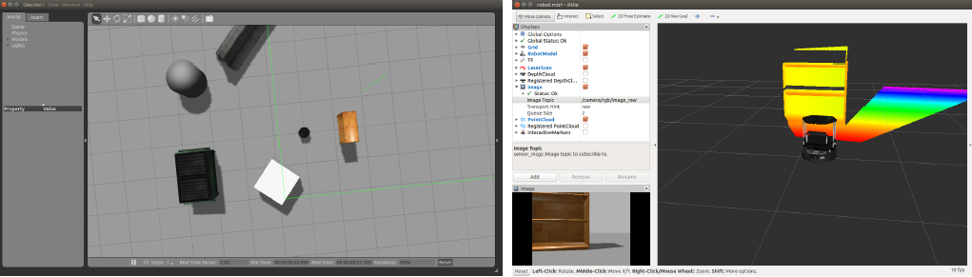
Turtlebot Simulator
Before running, open ~/.bashrc file and comment out lines containing:
ROS_HOSTNAME and ROS_MASTER_URI
$ roslaunch turtlebot_gazebo turtlebot_world.launch
$ roslaunch turtlebot_teleop keyboard_teleop.launch
$ roslaunch turtlebot_rviz_launchers view_robot.launch
turtlebot_gazebo
turtlebot_rviz_launchers

Slide 29
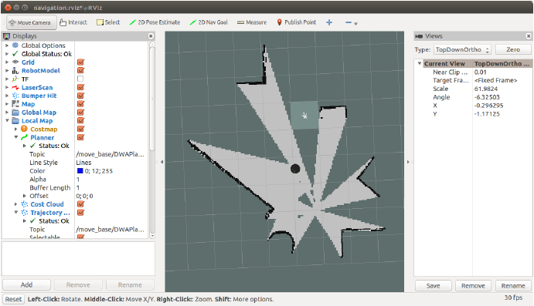
Turtlebot Gmapping
$ roslaunch turtlebot_gazebo gmapping_demo.launch
$ roslaunch turtlebot_rviz_launchers view_navigation.launch

Slide 30
Commonly Used ROS Commands
$ rospack find <package_name>
$ rospack libs-only-L <package_name>
$ rospack depends1 <package_name>
$ roscore
$ rosrun <package_name> <executable_name>
$ roslaunch <package_name> <launch_name>
$ rostopic list
$ rostopic echo <ros_topic>
$ rostopic type <ros_topic>
$ rosmsg show <ros_message>

Slide 31
Ubuntu Distribution
The current TurtleBot netbook has 14.04 LTS (Trusty) Ubuntu distribution installed
Each group is recommended to have a workstation/remote computer
You can find the installation DVD image in the USB drive
(for dual boot) Burn ISO image into CD, (or) use Startup Disk Creator to burn image onto USB key.

Slide 32
Installation Instructions
Dual boot:
Backup important files and create a new partition
Boot from DVD or USB key (change boot setting from BIOS)
Install into new partition
Using VirtualBox image (for any Windows or Linux):
Install VirtualBox and VirtualBox Extension Pack https://www.virtualbox.org/wiki/Downloads
Run VirtualBox, File->Import virtual appliance, or
Create new Ubuntu image

Slide 33
Commonly Used Terminal Commands
$ gedit <path/filename> (edit text document)
$ sudo <command_that_requires_admin_prev>
Admin account: turtlebot-admin
Password: (ROS2015
$ pwd (returns current directory)
$ cd <directory> (go into directory)
$ ls (list files in current directory)
$ cp -r <file/directory> <destination> (copy)
$ mkdir <folder_name> (create folder)
$ ./<file_to_run> (run a file)
…
More information:
http://www.dummies.com/how-to/content/common-linux-commands.html
http://www.thegeekstuff.com/2010/11/50-linux-commands/

Slide 34
ROS and TurtleBot installation for remote computer
install ROS desktop
$ sudo sh -c 'echo "deb http://packages.ros.org/ros/ubuntu $(lsb_release -sc) main" > /etc/apt/sources.list.d/ros-latest.list'
$ sudo apt-key adv --keyserver hkp://pool.sks-keyservers.net --recv-key 0xB01FA116
$ sudo apt-get update
$ sudo apt-get install ros-indigo-desktop-full
$ sudo apt-get install python-rosinstall
$ sudo rosdep init
$ rosdep update
install packages for TurtleBot
$ sudo apt-get install ros-indigo-turtlebot ros-indigo-turtlebot-apps ros-indigoturtlebot-interactions ros-indigo-turtlebot-simulator ros-indigo-kobuki-ftdi ros-indigo-rocon-remocon ros-indigo-rocon-qt-library ros-indigo-ar-trackalvar-msgs ros-freenect-launch
install additional drivers/utilities
$ sudo apt-get install chrony acpi cutecom nautilus-open-terminal spyder

Slide 35
Additional settings on remote computer
Add following to ~/.bashrc of remote computer
Replace <IP of remote computer> with the actual IP
export TURTLEBOT_BATTERY=/sys/class/power_supply/BAT0
export TURTLEBOT_BASE=create
export TURTLEBOT_STACKS=circles
export TURTLEBOT_3D_SENSOR=kinect
source /opt/ros/indigo/setup.bash
export ROS_MASTER_URI=http://<IP of TurtleBot computer>:11311
export ROS_HOSTNAME=<IP of remote computer>
For TurtleBot, run these to add usernames to dialout group
$ sudo adduser turtlebot dialout
$ sudo adduser <username> dialout

Slide 36
Where to Start?
Go to the ROS Getting Started guide and read it.
http://www.ros.org/wiki/ROS/StartGuide
Go to the ROS Tutorials page, and start working through the Beginner Level tutorials there.
http://www.ros.org/wiki/ROS/Tutorials
Practise with TurtleBot simulator
http://wiki.ros.org/turtlebot_simulator
More technical video tutorial:
http://www.youtube.com/playlist?list=PLDC89965A56E6A8D6

